Slide 1
205 Oct 7, Class 6
Chapter 5, Statistics
  Descriptive statistics
  Inferential statistics
  Data visualization
Practical approaches
  Calculating statistics
  Reporting statistics
  Data visualization

Slide 2
Descriptive statistics for Exp 1
Working with spreadsheets
  Selecting cells, selecting ranges, entering formulas
Mean
  =average()
Standard deviation
  =stdev.s()
Standard error
  SD/sqrt(n)
  Counting n
  Building a formula

Slide 3
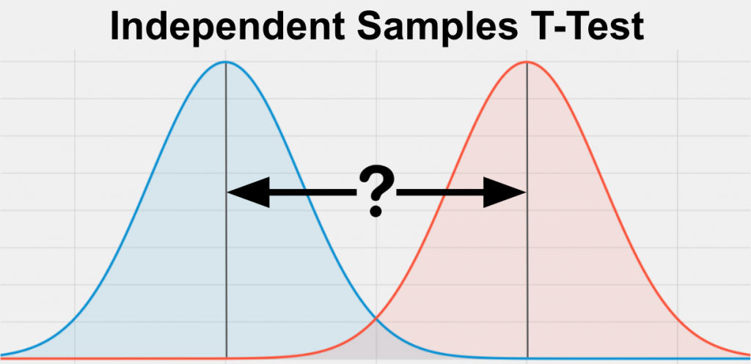
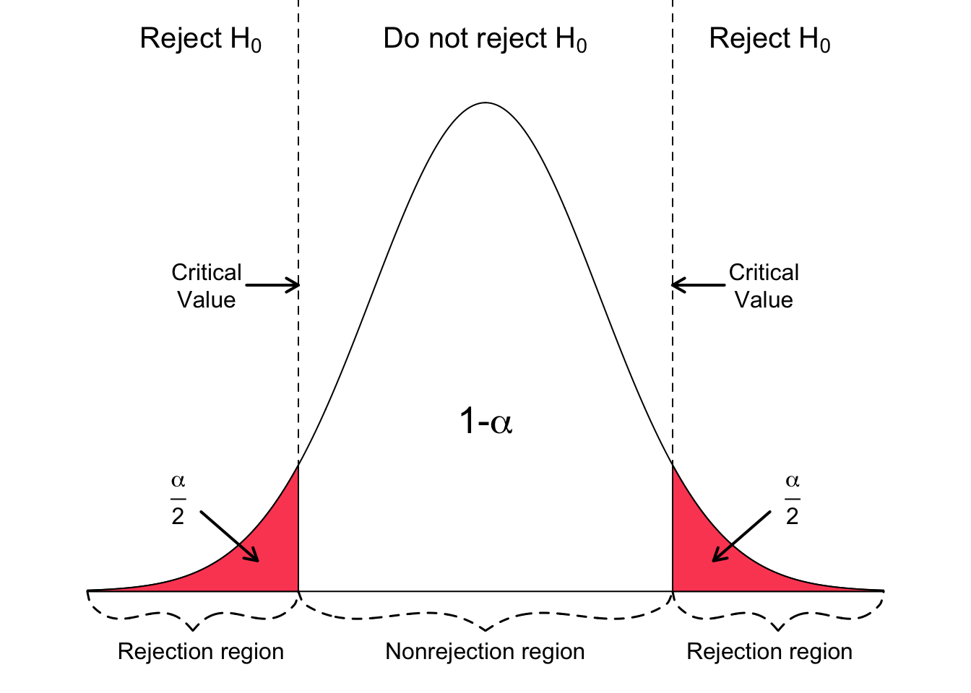
Theory: t-test
t = mean difference / variance
Data distributions for two conditions

Slide 4
Practical Inferential Statistics
Running a t-test on data
  Two independent samples t-test
  Assuming equal variances
  Applying a 2-tailed criterion
    Alpha = .05
Software
  R & RStudio – free, highly accurate
  SPSS – expensive, highly accurate
  MS Excel – available, slightly inaccurate

Slide 5
Using R
Installing R
  Installing RStudio
  Programming environment
Running commands
Multiple panes of information
Using the correctly formatted version of the data
  The ‘.csv’ file is set up slightly differently
Following the given recipe
  Once everything is configured, just Run->

Slide 6
Reading statistical output
All statistical programs produce a lot of information
Communicating the results
  Parsing the output
  Selecting the correct values
  Reporting in APA format
t(df) = X.XX, p < .YYY
  t(df) = X.XX, p = .yyy

Slide 7
Writing your results section
Includes both descriptive and inferential statistics
Give the performance of both groups
State the direction of the effect
Support with inferential statistics
Very compact, but high-risk
  Triple check your numbers

Slide 8
Fill in the reporting template
“On the recognition test, the Condition-A participants exhibited performance of XXX [units] (SD XX; SE XX) while the Condition-B participants exhibited performance of XXX [units] (SD XX; SE XX). The Condition-A group performed significantly better than the Condition-B group, t(xx)=ZZZ, p<YYY.”
Replace
  Condition-A, Condition-B
  Optionally: ‘exhibited performance’
  Include ‘units’
  Add all the numbers, descriptive and inferential

Slide 9
Making a figure
Back to Excel
Getting a basic graph is straightforward
Necessary edits
  Label the y-axis
  Add SE bars
Recommended edits
  Remove title, gridlines
Optional edits
  Colors, layout, design

Slide 10
For Wed Oct 9
Chapter 7, Within-participants design
Start drafting your first writeup (Chapter 6)
  Write your results section
    Add your figure including caption/note

